Slide 1
Particle Accelerator Simulation
Anthony Zummo, Bomin Zhang

Slide 2
Goal
Simulate a particle accelerator colliding e⁻ and e⁺
Focus on the physics of the collision and particles subsequently produced
Model particles traveling through magnetic field using differential equations
Use Monte Carlo methods for decays, masses, lifetimes, etc.
Trace the simulated particles pathway and plot whole process in 3-D
Design an interface with Tkinter, which allows us to illustrate each process in collision

Slide 3
Modeling Particles
All particles modeled as point particles
c = 1 to simplify units
[Mass] = MeV/c**2
[Momentum] = MeV/c
[Energy] = MeV
[Time] = fs (10^-15)

Slide 4
Modeling Particles
Use a class that contains all information about each particle
Mass
Charge
Lifetime
Position and Velocity
Energy and Momentum

Slide 5
Modeling Particles (Position, Velocity)
Most prominent force on particles is from the magnetic field
Charged particles will travel in helices
Neutral particles travel in straight lines
Modeled with fairly simply differential equations
dx/dt = vx dy/dt = vy dz/dt = vz
dvx/dt = 0 dvy/dt = vz*q*B/m dvz/dt = -vy*q*B/m

Slide 6
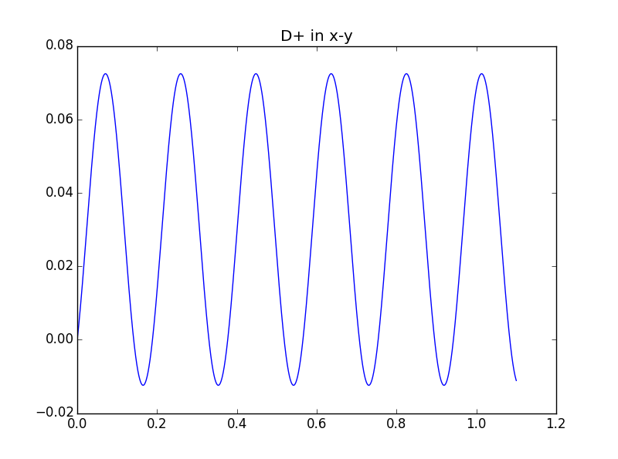
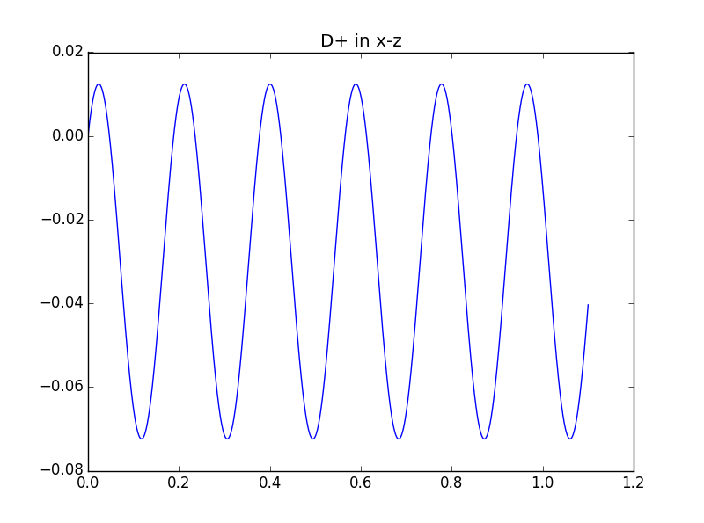
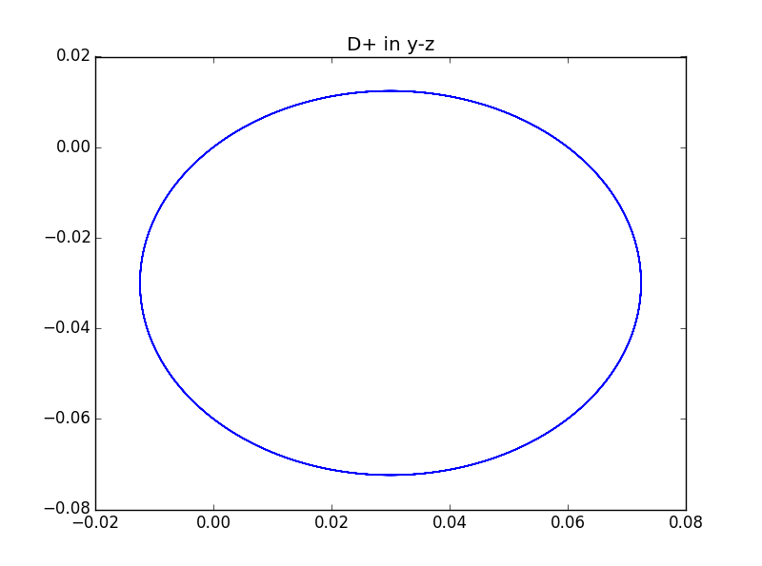
Path & Travel
Plot the x-y, x-z, y-z to illustrate the movement in each cases
B-field is along x axis

Slide 7


Modeling Particles (Mass, Lifetime)
Unstable particles do not have well defined mass
Width of mass distribution is proportional to lifetime
Mass follows Breit-Wigner Distribution
τ = ħ/Γ

Slide 8
Particle model
Takes relativity into account
Has Lorentz Boost method to boost from Center of Mass frame to Lab Frame.
Particle parameters based on data from pdg.lbl.gov

Slide 9
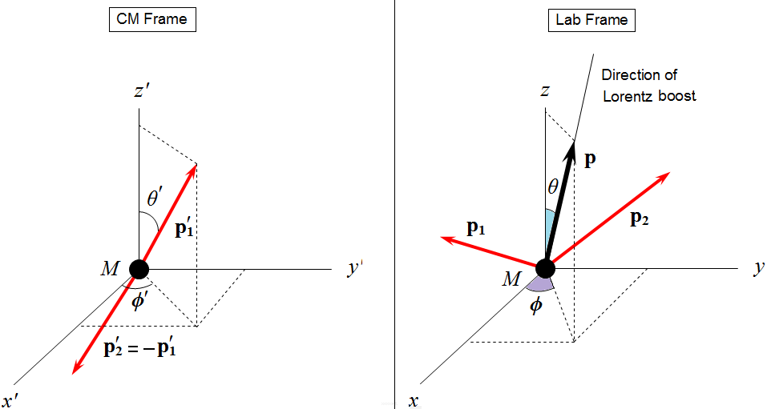
Two Body Decays
Everything done in CM Frame
Momentum is conserved
Daughters have equal and opposite momenta
Energy is conserved
Particles are produced at random isotropic angles

Slide 10







Two Body Decays

Slide 11
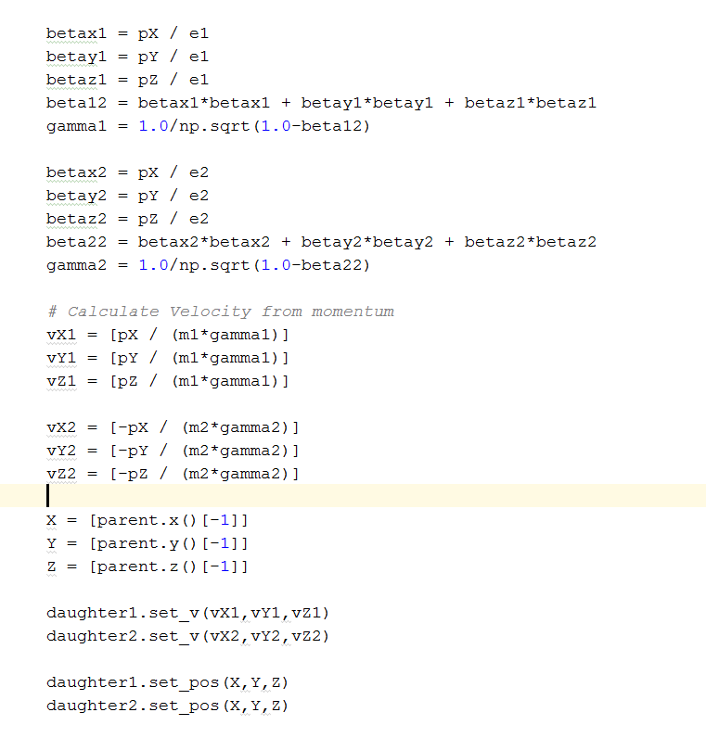
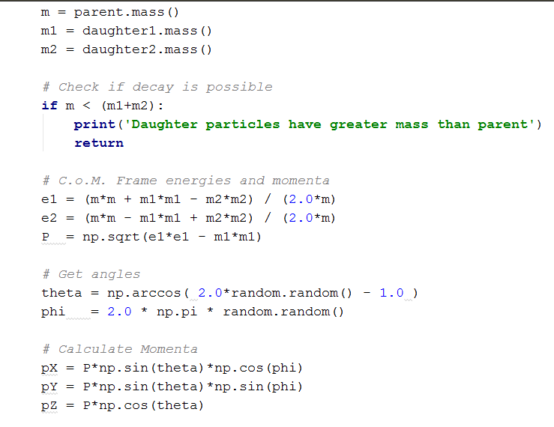
Two Body Decay Function

Slide 12
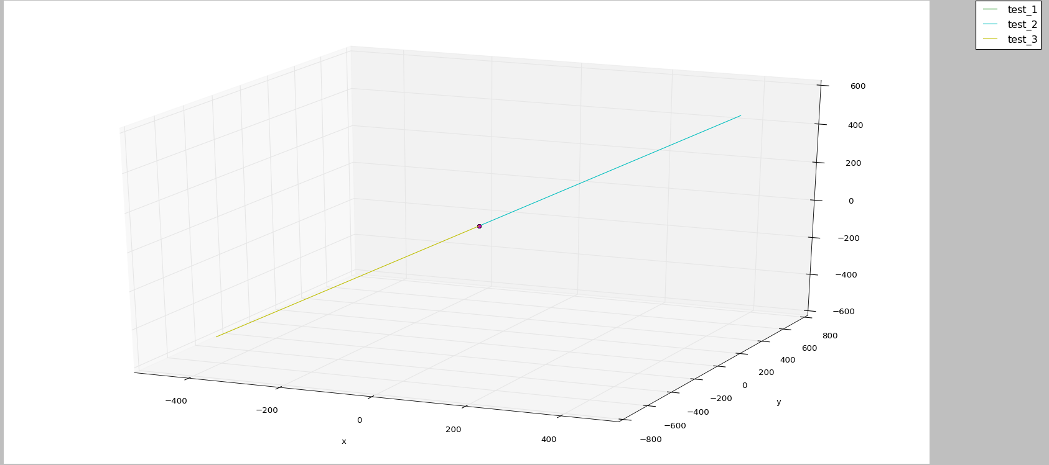
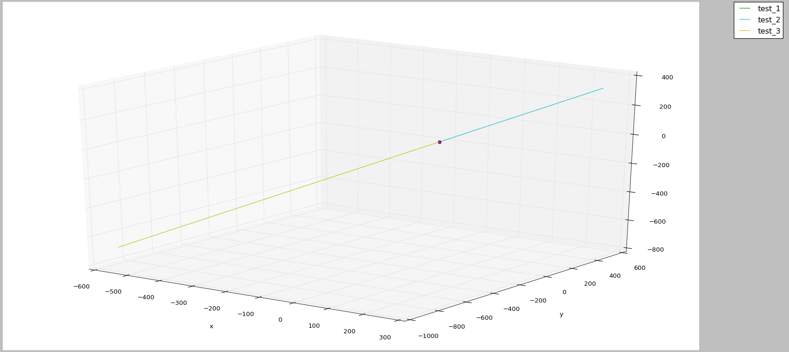
Two Body Decay Examples (From Rest)
M₁ = M₂
M = 2*M₁ = 4*M₂

Slide 13
Two Body Decay

Slide 14
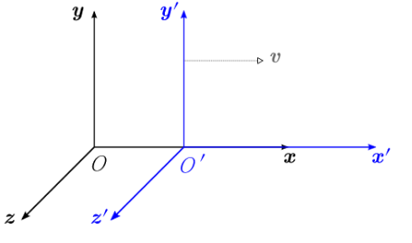
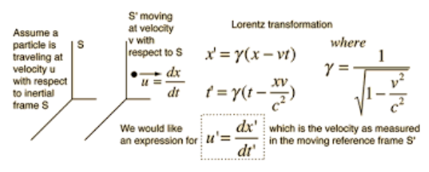
Lorentz Boost

Slide 15
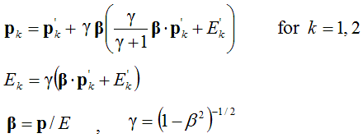
Lorentz Boost

Slide 16
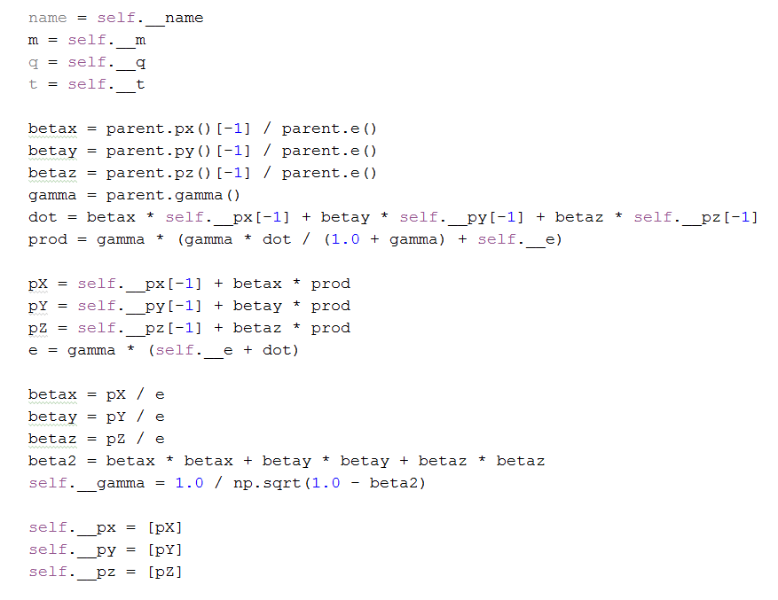
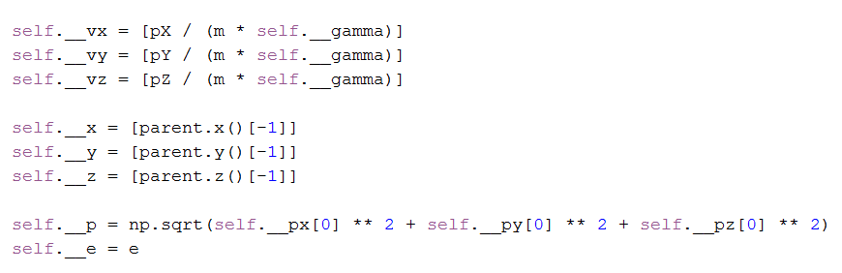
Lorentz Boost

Slide 17

Lorentz Boost
V₀ = .5 * c M₁ = M₂

Slide 18
Decay Chain
Unstable particles decay after a certain period of time
When they decay, the particles they decay to are random but based on probabilities
eg. D0 has an 11% chance of decaying to K+ and rho-
Information on these probabilities comes from the Particle Data Group (http://pdg.lbl.gov/)

Slide 19
Decay Chain
The branching fractions of each particle can be modified for a more realistic simulation or to look at a specific decay
A pair of particles are produced in the initial collision
Each parent will decay to two daughter particles
Decay chain produces a list of the particles in the simulation

Slide 20
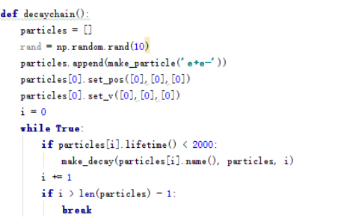
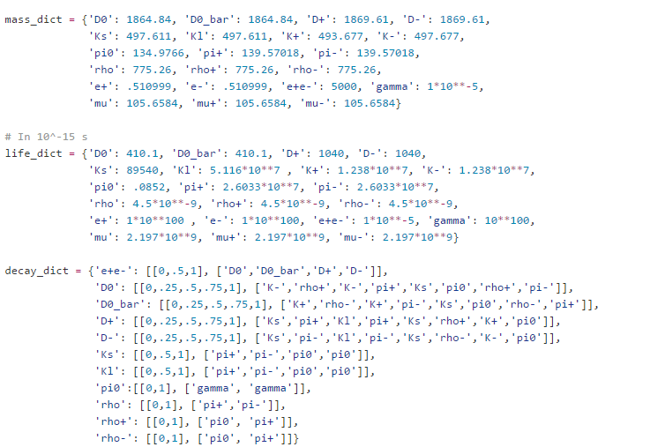
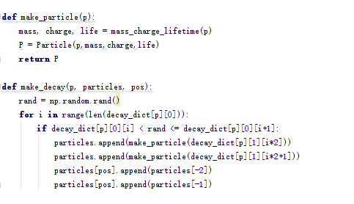
Decay Chain code

Slide 21
Main
Iterate over each particle
Allow each to travel for its lifetime (taking special relativity into account)
If the particle decays use the two body decay function
Plot all particle’s paths in a 3-D graph
Output information on each particle:
Mass
Lifetime
Energy
Momenta

Slide 22
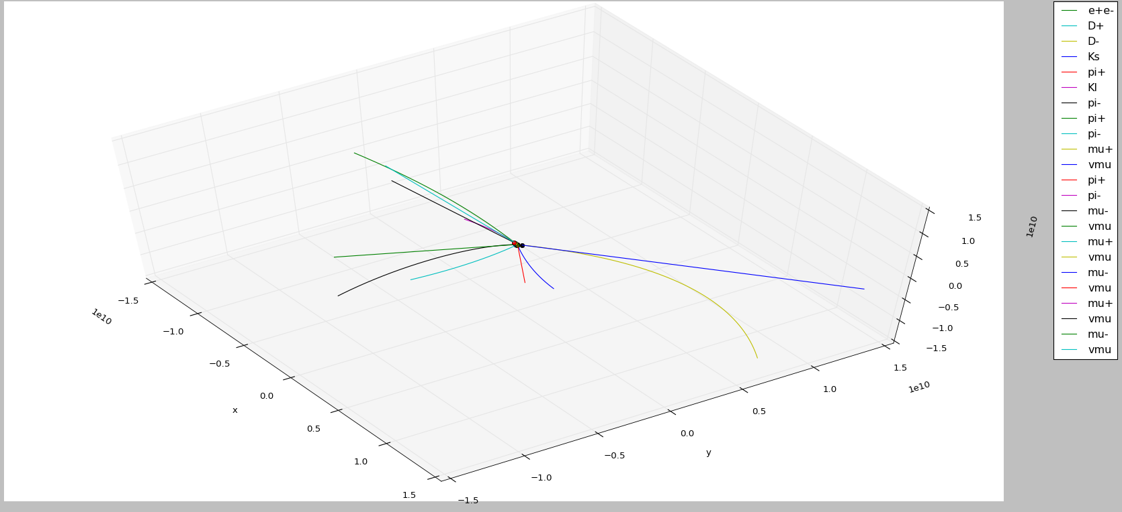
Plots

Slide 23
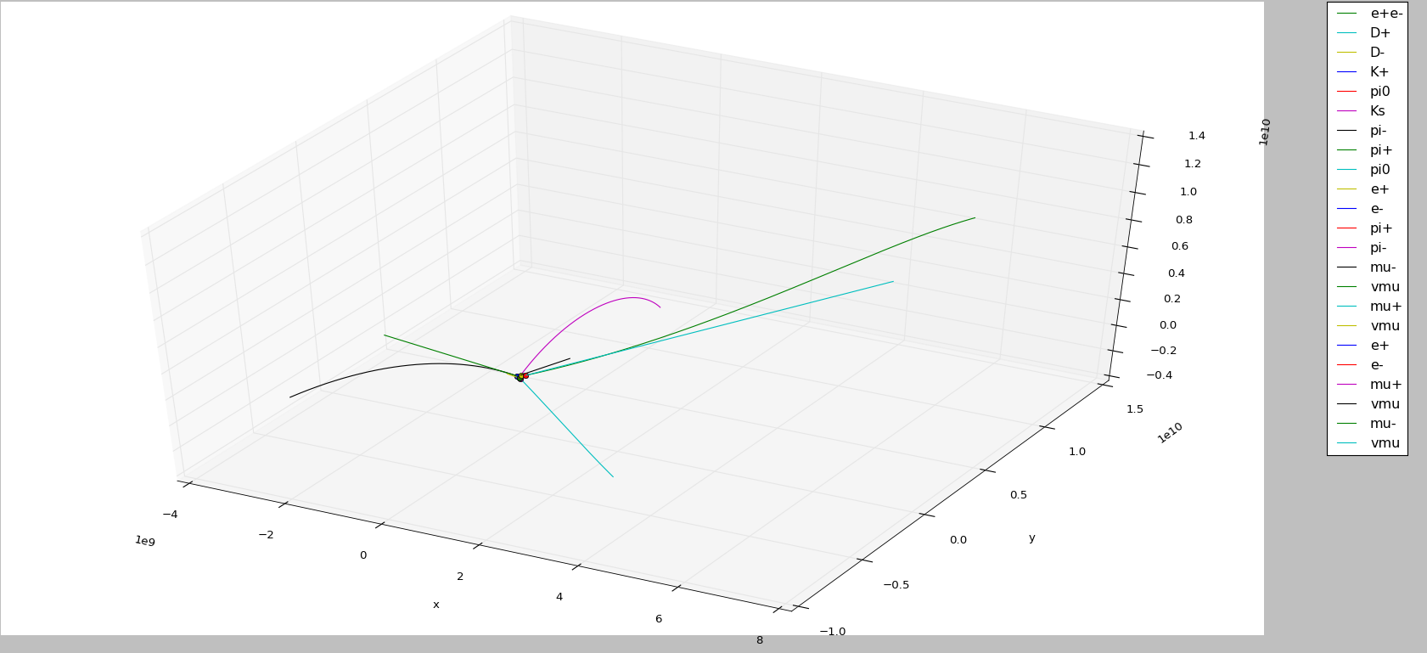
Plots

Slide 24
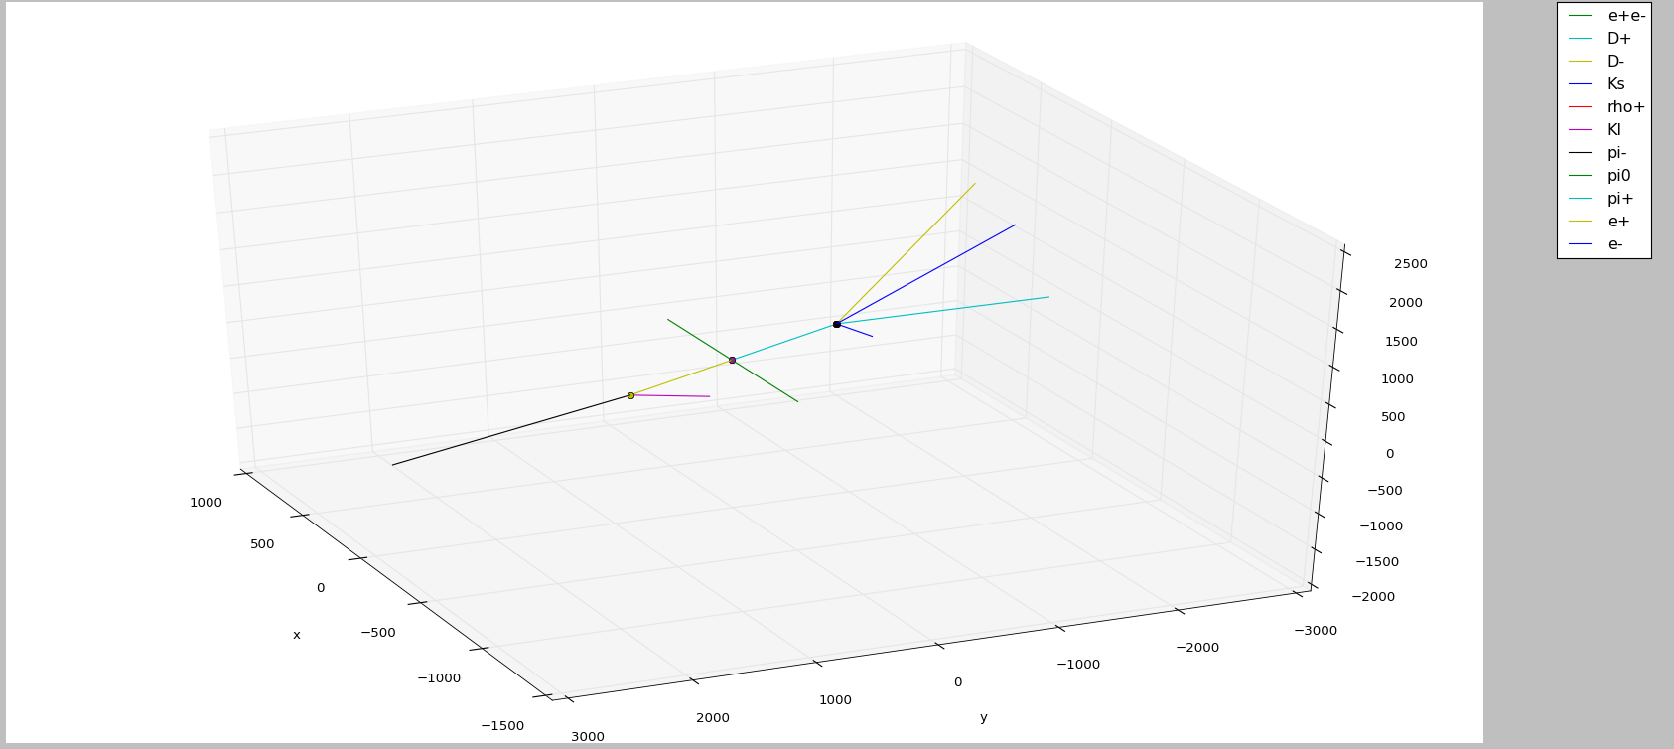
Plots

Slide 25
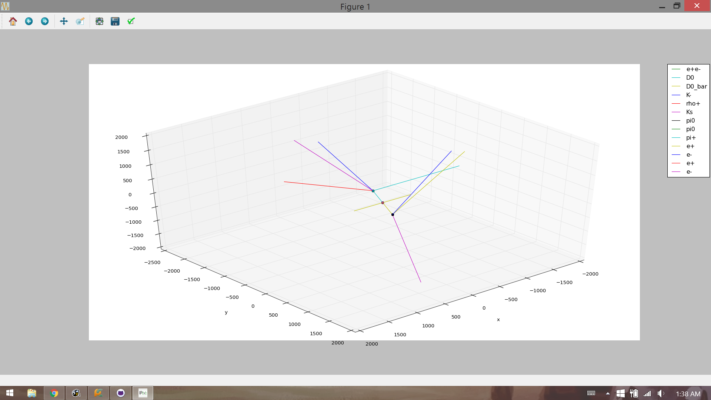
Plots

Slide 26
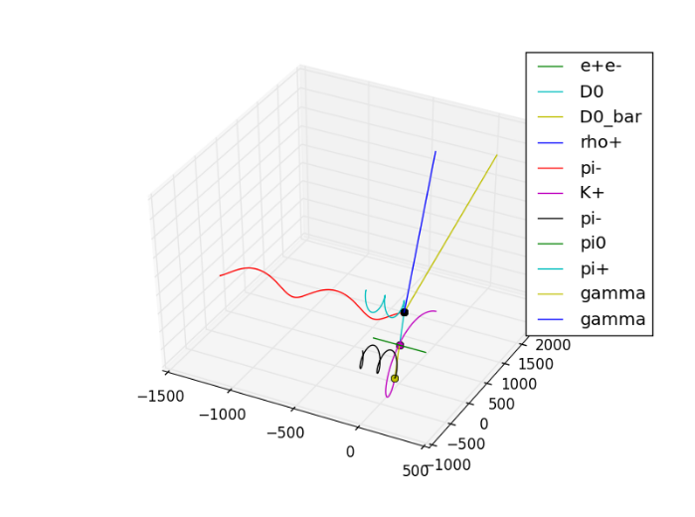
Thanks!

Slide 27
References
http://pdg.lbl.gov/
http://www1.gantep.edu.tr/~bingul/simulation/twoBody/
http://www.helsinki.fi/~www_sefo/phenomenology/Schlippe_relativistic_kinematics.pdf
http://ph381.edu.physics.uoc.gr/Particle_Accelerator_Physics.pdf
http://hyperphysics.phy-astr.gsu.edu/hbase/relativ/relcon.html

